Slide 1
Cryptocurrency Analysis and Prediction
Group Member: Qingxing Li, Yuying Wang, Sichun Hao

Slide 2



Background
Investing in cryptocurrencies has been the new direction in recent years. A lot of persons made their fortunes overnight by investing in cryptocurrencies.
Our team wonders if we can use what we've learned to predict the price of cryptocurrencies.

Slide 3
Data Source
We get the dataset from Kaggle: https://www.kaggle.com/sudalairajkumar/cryptocurrencypricehistory
We use two kinds of datasets.
Price DataSets: observed date, closing price, high and low price and market capitalization for 15 categories of cryptocurrencies.
Bitcoin and Ethereum Datasets: 24 kinds of features for Bitcoin and Ethereum which are the two most famous cryptocurrencies nowadays.

Slide 4
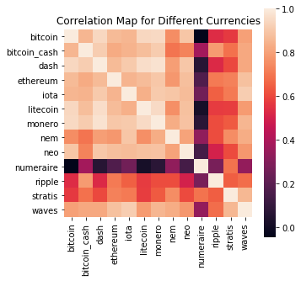
Data Analysis-Correlation Between Currencies
Spearman rank correlation: Spearman rank correlation is a non-parametric test that is used to measure the degree of association between two variables.
-----------wikipedia

Slide 5
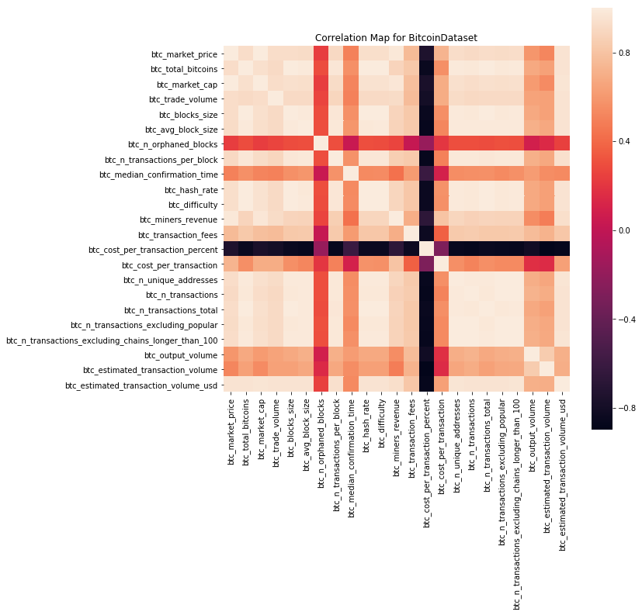
Data Analysis-Bitcoin Dataset
General, after calculate the absolute value.
0-0.09: no correlation
0.1-0.3: weak correlation
0.3-0.5: moderate correlation
0.5-1.0: strong correlation

Slide 6
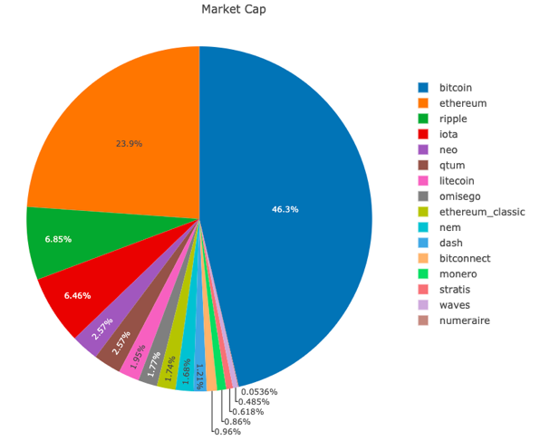
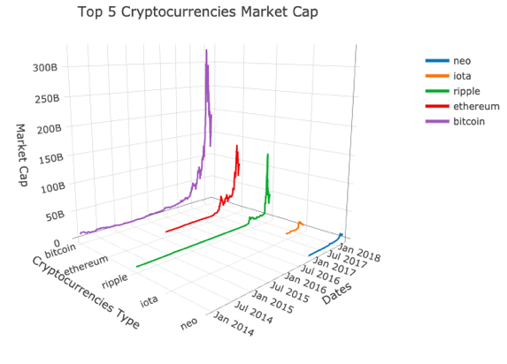
Data Analysis-Market Capitalizations
We first compute the market cap for the 15 categories of cryptocurrencies.

Slide 7
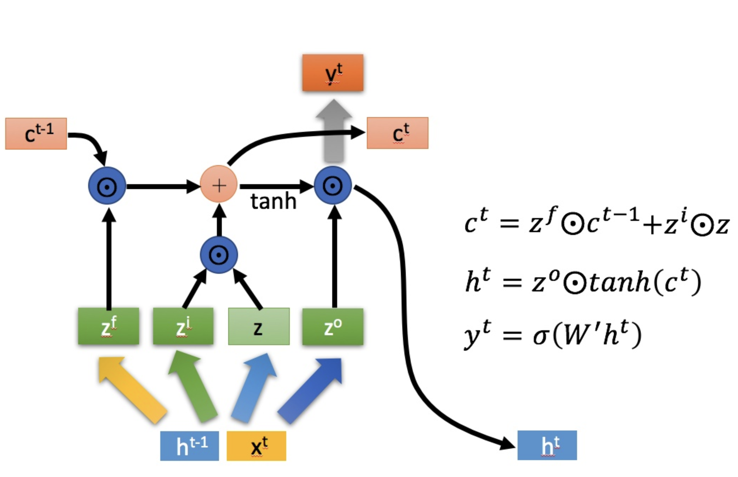
Prediction
LSTM(Long short-term memory)
Time Series Analysis and Prediction
A special RNN (Recurrent Neural Network)
Can solve the gradient disappear and explosion
Remember what need to be remembered for a long time, forget information that doesn’t matter

Slide 8
LSTM -- training
Preprocessing
Lossing data in a long window: drop
Lossing data in small window: fill as the previous one
No outliers
Parameters
Training Window: 10 days
Training Epoch: 50
Loss Function: mse
Activation function: Relu
Neurons: 50
Notes:
parameters

Slide 9
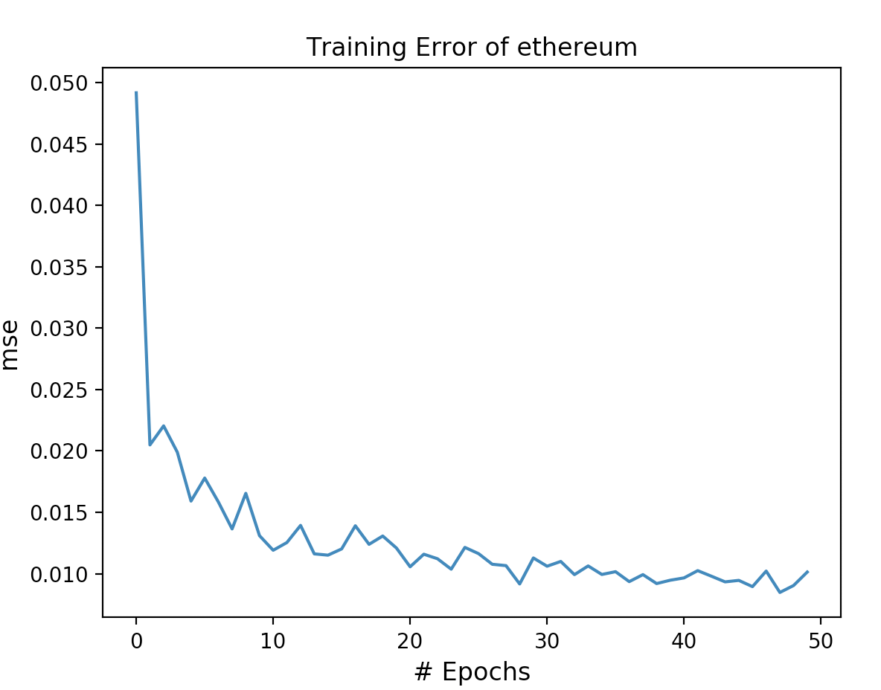
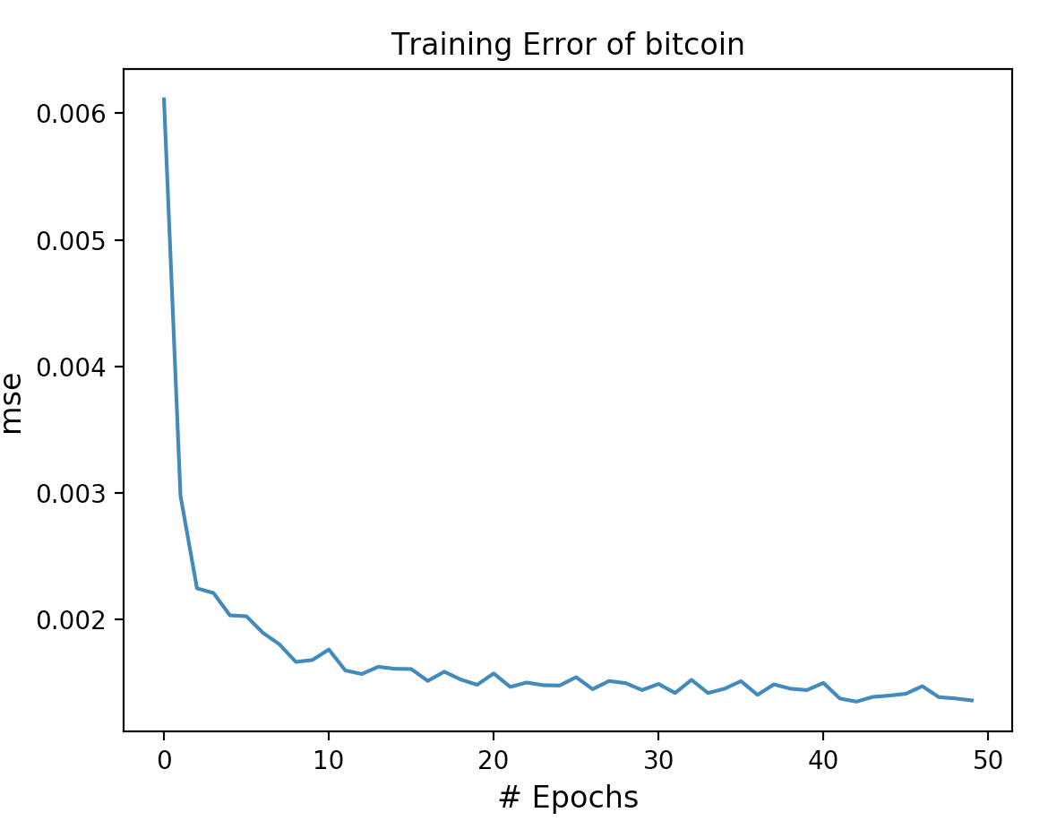
Prediction -- training error
Notes:
Converge
Bitcoin is better than Ethereum
Reason: more data

Slide 10
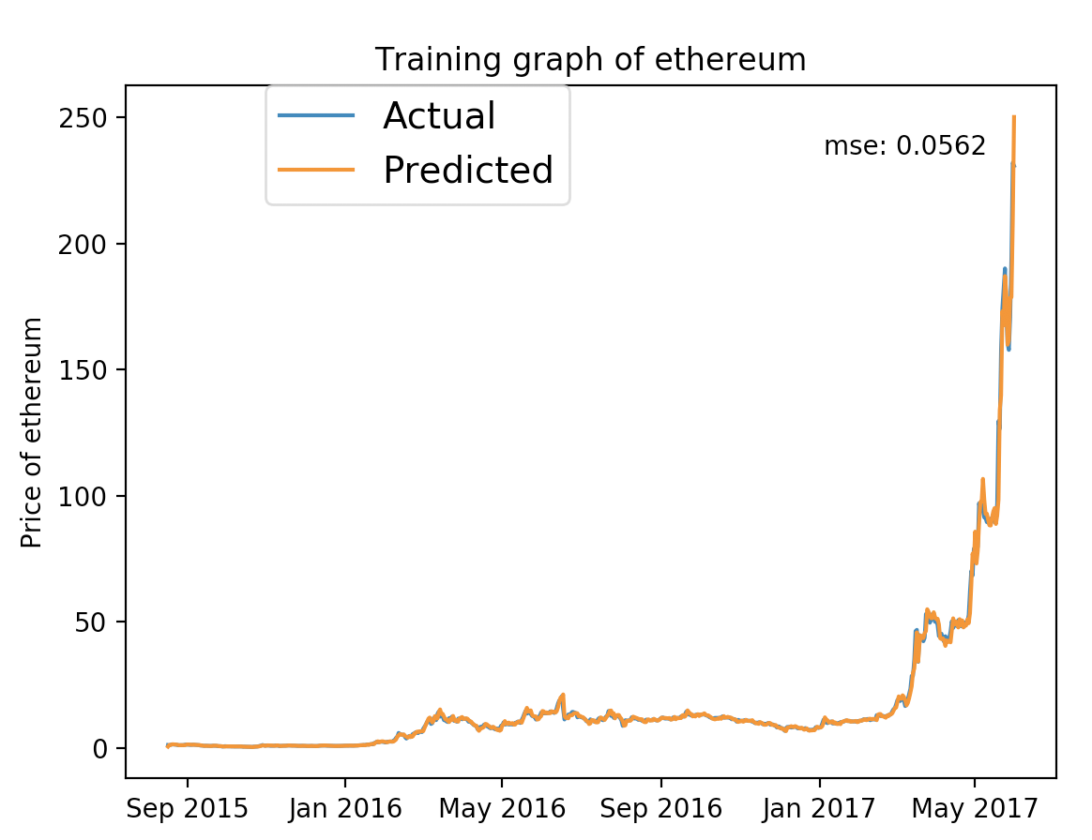
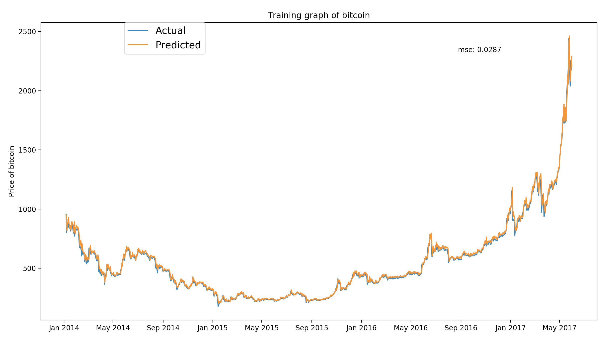
Prediction -- training fits

Slide 11
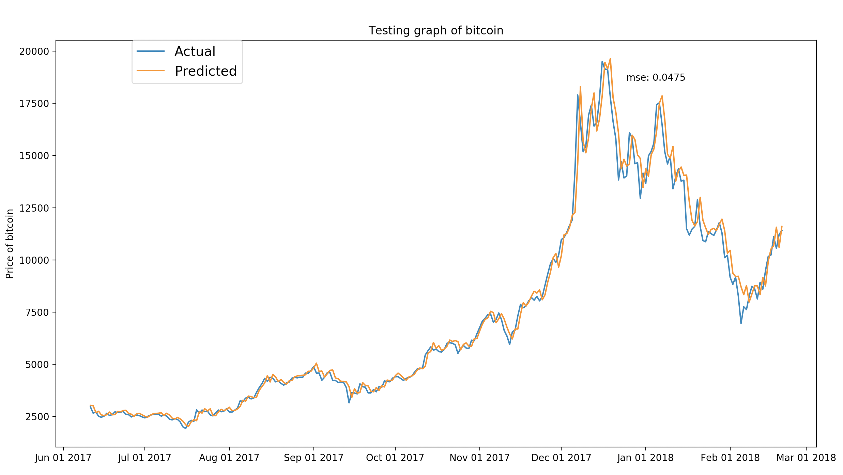
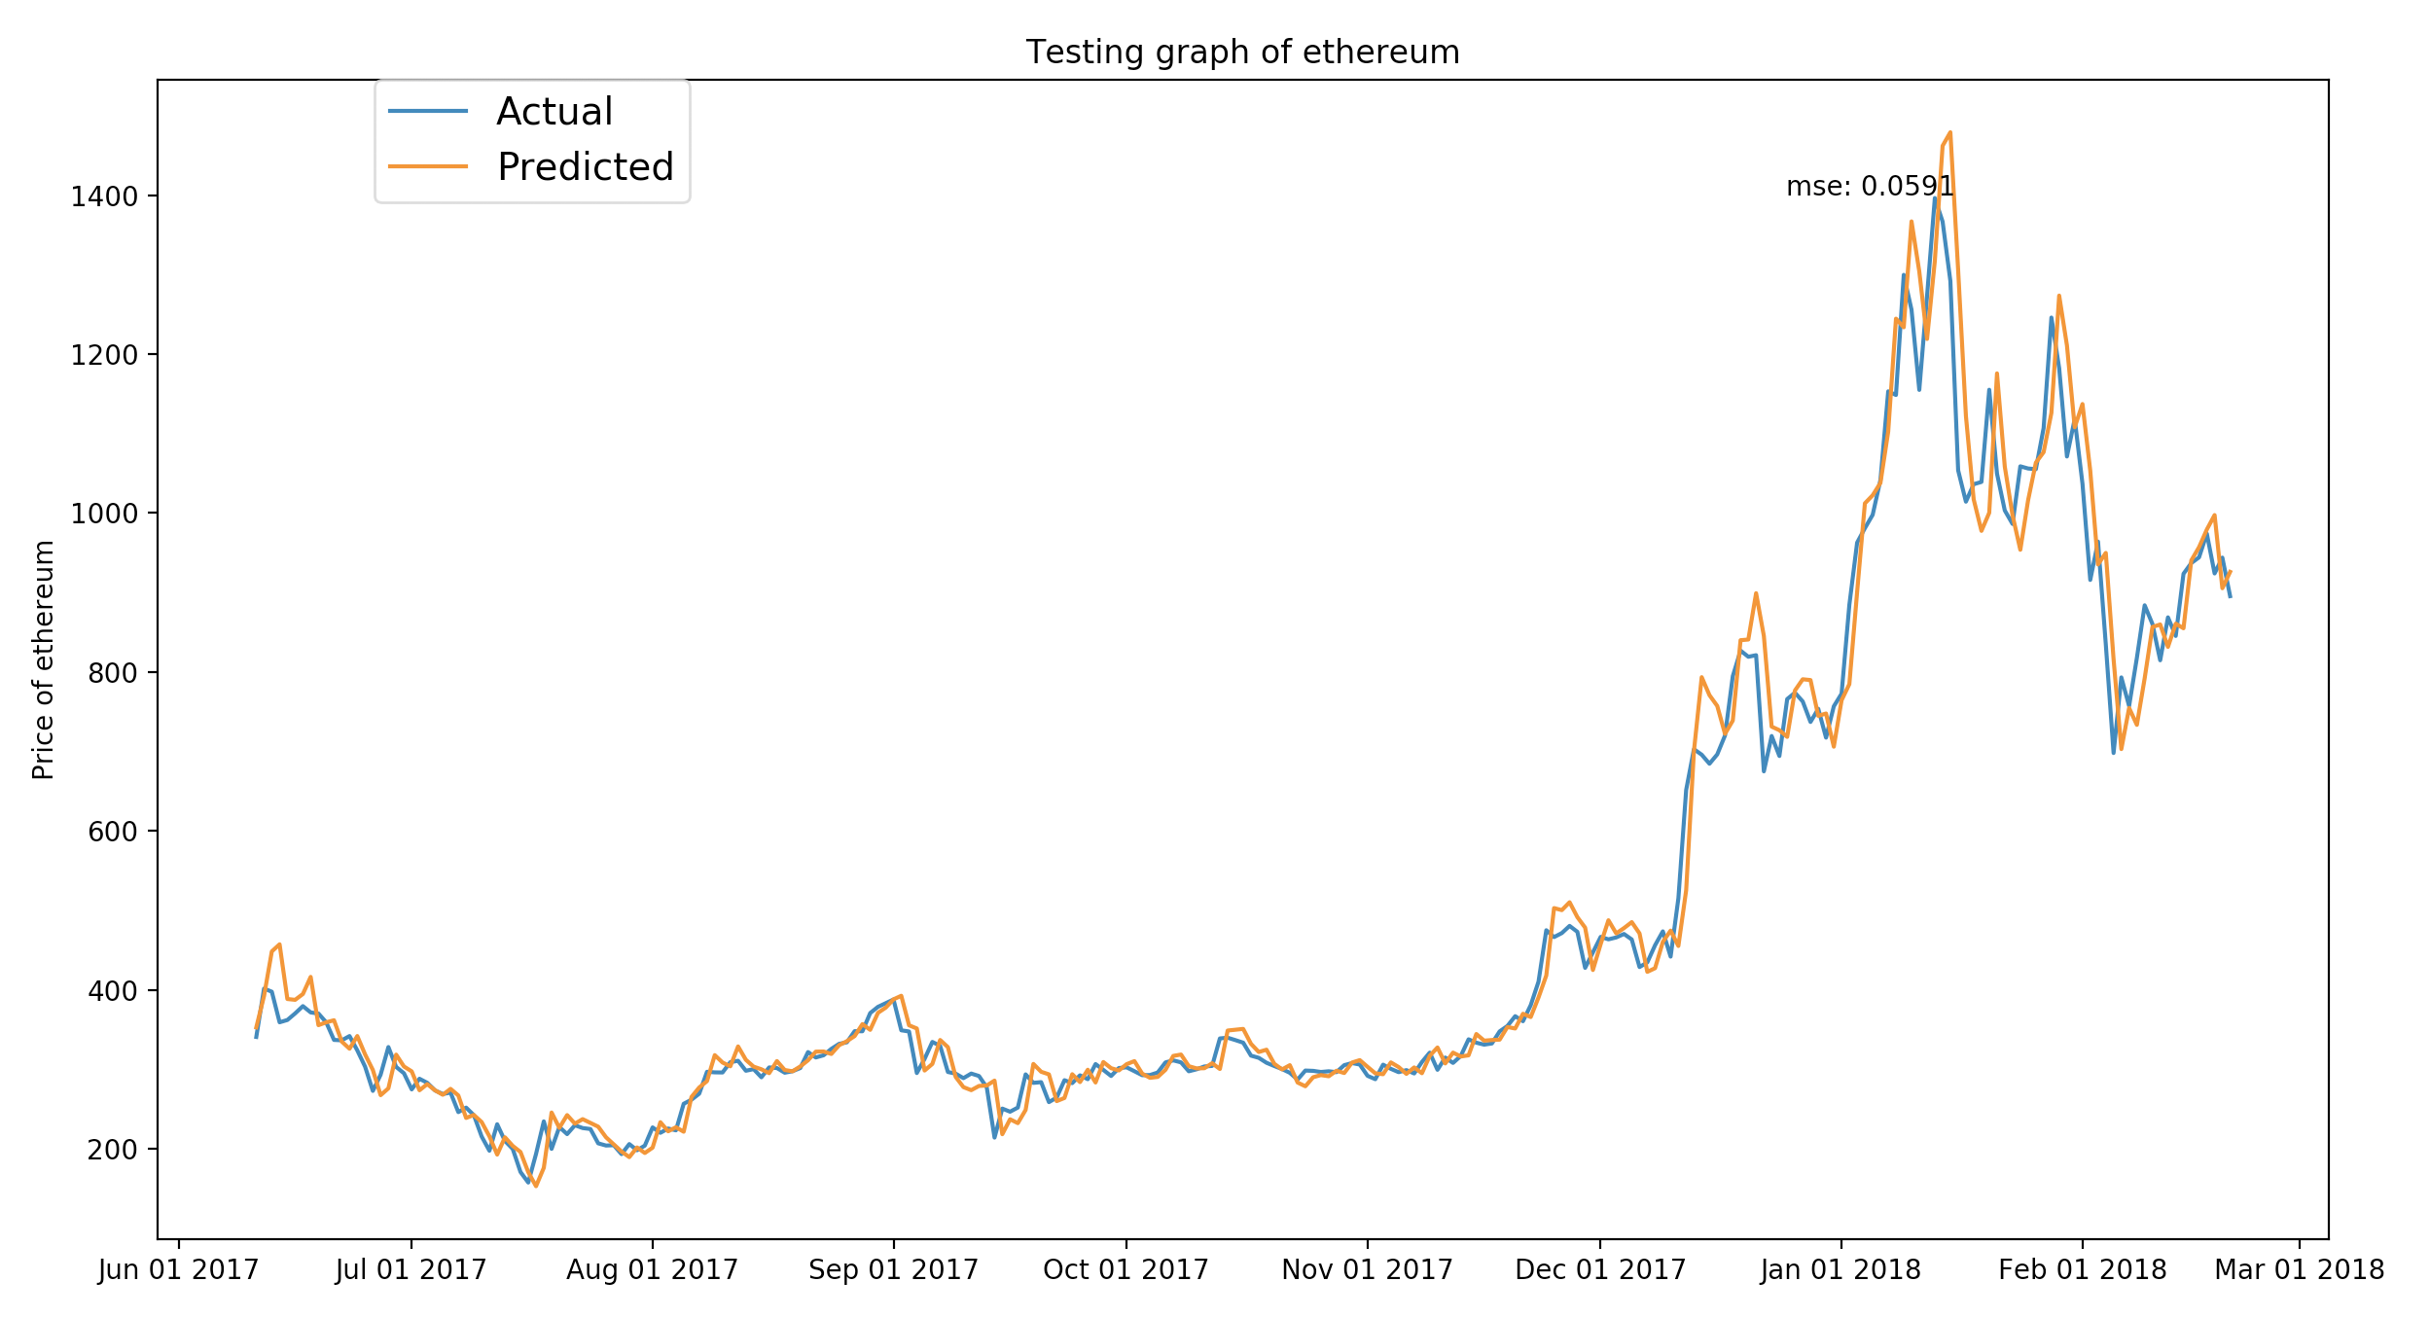
Prediction -- testing (Jun 2017- Mar 2018)
Notes:
Delay
Looks good,
But look carefully, you will find that our prediction have a delay compares to the market, and are always gives a higher price than the real prices
So we will try to update the algorithm to use the data in future when training

Slide 12
Thank you for Listening

